Slide 1

Presentation On
SMART CARD

Slide 2

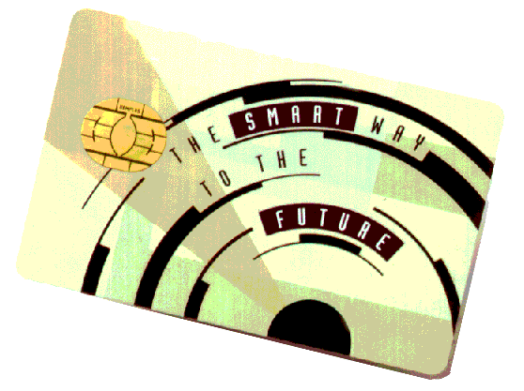

Slide 3
CONTENT :
INTRODUCTION
HISTORY OF SMART CARD TECHNOLOGY
WHAT IS SMART ABOUT SMART CARDS
CATEGORIES OF SMART CARD ..……
DESIGN…..
TYPES OF SMART CARDS…
DATA STORAGE IN SMART CARD….
APPLICATIONS OF SMART CARDS……
ADVANTAGES OF USING SMART CARDS..
DISADVANTAGES….
SECURITY WITH SMART CARDS …
SMART CARDS IN INDIA….

Slide 4
INTRODUCTION :
WHAT IS SMART CARD ??
A Smart Card is a small plastic card
embedded with an IC(integrated circuit) chip.
Smart cards can hold up to 32,000 bytes.
It also contains OS. The classification based on OS varies.

Slide 5
HISTORY :
1968- German inventors patent combination of plastic cards with micro chips.
1970- Japan patent different version.
1974- Roland Moreno invents integrated chip card and patents it in France.
1977- Motorola produces first smart card microchip.

Slide 6
1979- Motorola develops first single chip microcontroller for bank in France.
1982- ATM cards with smart chips tested and smart chips placed on telephone cards.
1991- AT&T declared its contactless smart card.
1992- Germany uses smart card for health care.
1996- First university campus deployment of chip cards.

Slide 7

1992 s: Computer gaming world created.
2007 : Google introduces “street view”, a service that shows a view of an increasing no of positions such as road , indoor buildings .
2010 : 3D feature introduced of street view.
2014 : Facebook purchased a company that makes VR headsets.

Slide 8
WHY SMART CARD IS SO “SMART” ??
Smart cards are capable of not just storing data but also have processing power .
The data stored can be protected against unauthorized access.
Smart cards have property of multifunctionality……

Slide 9
CATEGORIES OF SMART CARDS..
Smart card ICs provide logic for specific application . The ICs are :
Memory Chips….
Microprocessor Chips….

Slide 10
DESIGN & PIN CONFIGURATION..

Slide 11
TYPES OF SMART CARDS..
Based on the interaction of smart cards with reader smart cards are of 3 types :-
Contact smart cards
Contactless smart cards
Hybrid (combination smart cards)

Slide 12
CONTACT TYPE SMART CARDS….
Contact smart cards have a contact area of approximately 1 square centimetre (0.16 sq in), comprising several gold-plated contact plate. These plate provide electrical connectivity when inserted into a reader , which is used as a communication medium between the smart card and a host (e.g., a computer) or a mobile telephone. Cards do not contain batteries, power is supplied by the card reader.

Slide 13
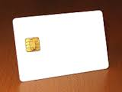
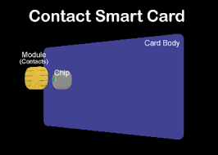
EXAMPLES OF CONTACT TYPE CARD..

Slide 14
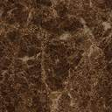
Contactless type smart card..
It uses RF technology to communicate with the readers.these type of cards rtequire only proximity to an antenna to communicate. Like contact smart cards ,contactless cards do not have internal power source instead they use an inductor to capture the incident light source and use it as the power to card….

Slide 15
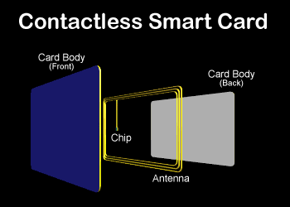
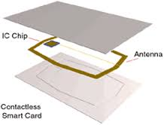
Some examples of contactless type card

Slide 16
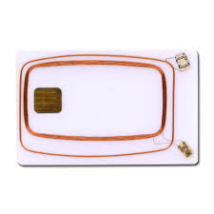
Hybrid type of smart cards…
Dual-interface cards implement contactless and contact interfaces on a single card with some shared storage and processing. An example is Porto's multi-application transport card which uses a chip with both contact and contactless (ISO/IEC 14443 Type B) interfaces.

Slide 17
Data storage in smart card…..
Data is stored in EEPROM in smart cards.
File types
Binary file (unstructured)
Fixed size record file
Variable size record file
MF
DF
DF
EF
EF
DF
EF
EF
EF

Slide 18
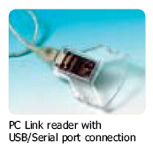
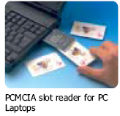

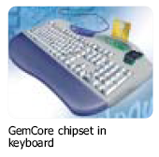
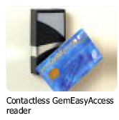
Smart card readers……

Slide 19

Applications …..
Identification
Financial:
..Banks
..Electronic Wallet
Educational institutes
In health care
In IT industry for more security through encryption
SIM cards.
And many more…..

Slide 20
Advantages of smart cards…..
1.Easy to use.
2.Individuals can have great convenience
3.Multiple task can be done by a single card
4.An important key in E-governence enhanced security

Slide 21
Problems associated with smart cards..
High probability of damage of cards.
Malware can break security model
There is some lack of security

Slide 22
Security with smart cards….
The standard security goals like :
authentication
Confidentiality
Integrity
Can easily be provided using smart cards.

Slide 23
Smart Cards in India…..
Gujarat is the first state to introduce a smart license system.
As student ID in institutes is of great importance.
In many public and private sectors for quick access of information.

Slide 24
THANK YOU…..

